Slide 1
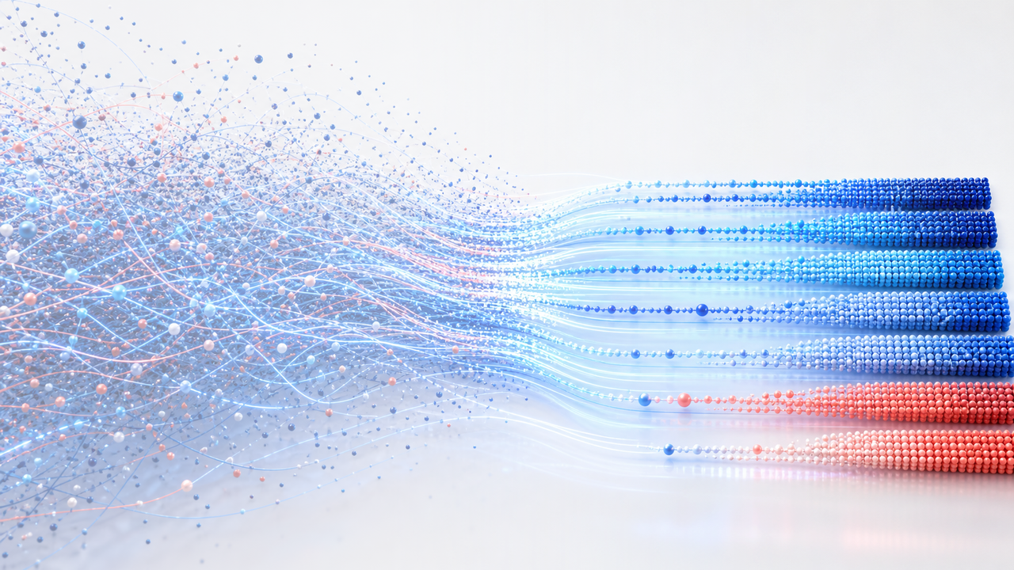
Order from Divergence
Mastering Large-Scale Computation
with Minimal Time Complexity Constants
Zhuoran Yi · Fei Yu
Utah Graphics Lab · VCL Imaging Group, Peking University

Slide 2
Introduction: Optimizing Execution Speed in OI
Pruning
Early Exit
if (bound <= best) return;
if (done) break;
Memoization
Constant Factors
if (memo[s] != -1)
return memo[s];
x += y;
if (x >= MOD) x -= MOD;
02

Slide 3

Introduction: Real-Time Graphics
03

Slide 4

Game on Screen
GPU
04

Slide 5

Experiment
constexpr int N = 1 << 24;
float x[N]; float a, b;
for (int i = 0; i < N; ++i) {
for (int k = 0; k < 128; ++k) {
x[i] = some_calc(x[i], a, b);
if (done[i]) break;
}
}
0.289 ms
0.276 ms
no break
break
05

Slide 6

Experiment
// 按照（提前预知的）break 先后排序
sort(ids, ids + N, by_exit_round);
// 某种神秘的 CUDA 显卡派发任务命令
update<<<grid, block>>>(ids, x);
// 等价于之前的一大车 for 循环
0.289 ms
0.166 ms
interleaved
grouped
06

Slide 7
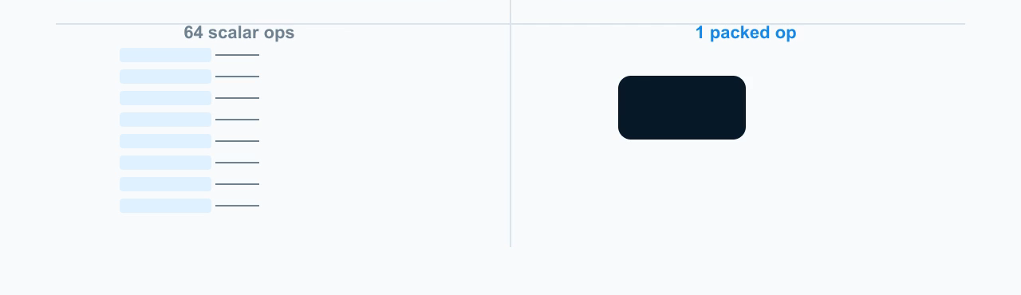
Example: bitset
naive
bitset
for (int i = 0; i < 64; ++i)
ans += a[i] & b[i];
bitset<64> A, B;
ans += some_popcount(A & B);
07

Slide 8
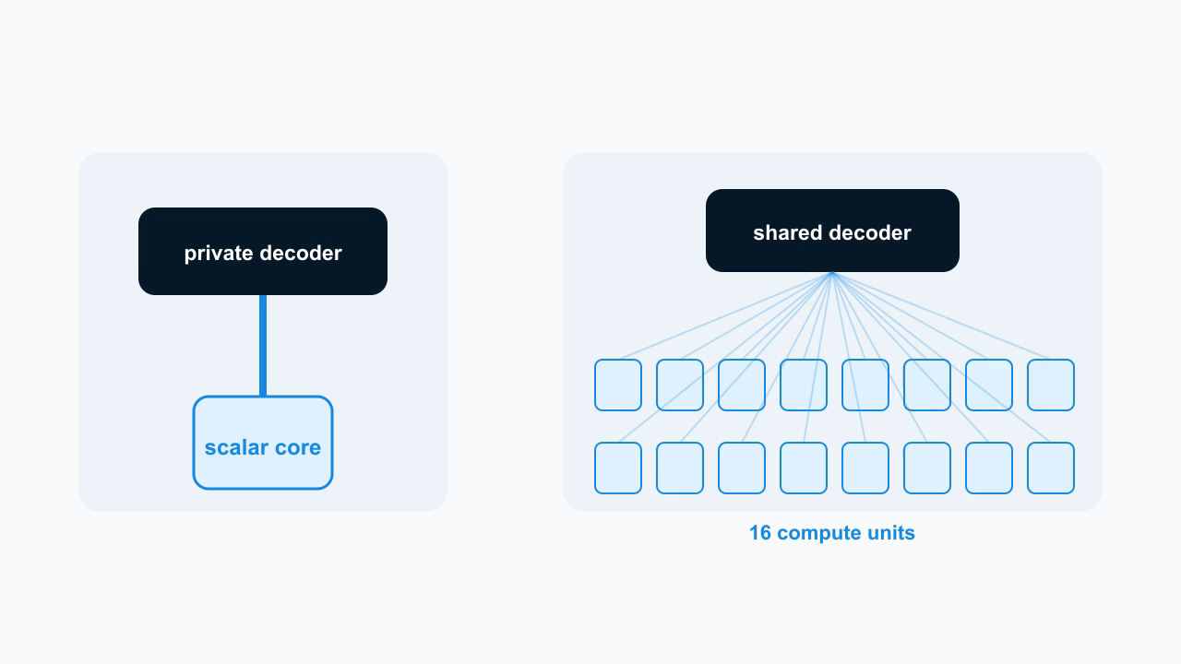
Hardware: Scalar vs SIMD
CPU
SIMD
08

Slide 9

Hardware: Array to Warps
W0
W1
W2
W3
W4
W5
W6
W7
09

Slide 10
CUDA: Warp Scheduling
warp queue
32 compute units
0
1
2
3
4
5
6
7
W0
W1
warp
scheduler
dispatch
8
9
10
11
12
13
14
15
W2
16
17
18
19
20
21
22
23
W3
W4
24
25
26
27
28
29
30
31
W5
active lane
idle lane
CUDA
__global__ void update(float* x) {
int i = global_thread_id();
x[i] = f(x[i]);
}
update<<<grid, block>>>(x); // 神秘 CUDA 命令，等价于开启若干个 update
10

Slide 11
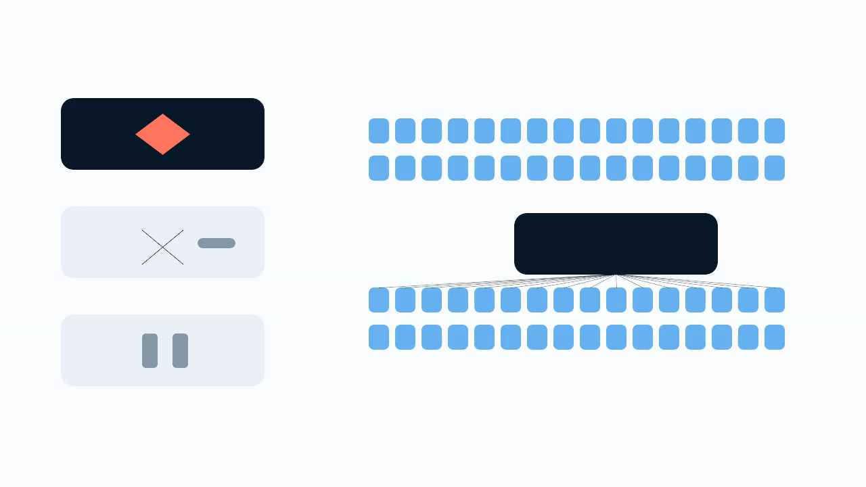
Divergence: Early Exit
if
W0
x[i] = f(x[i])
W1
wait
11

Slide 12
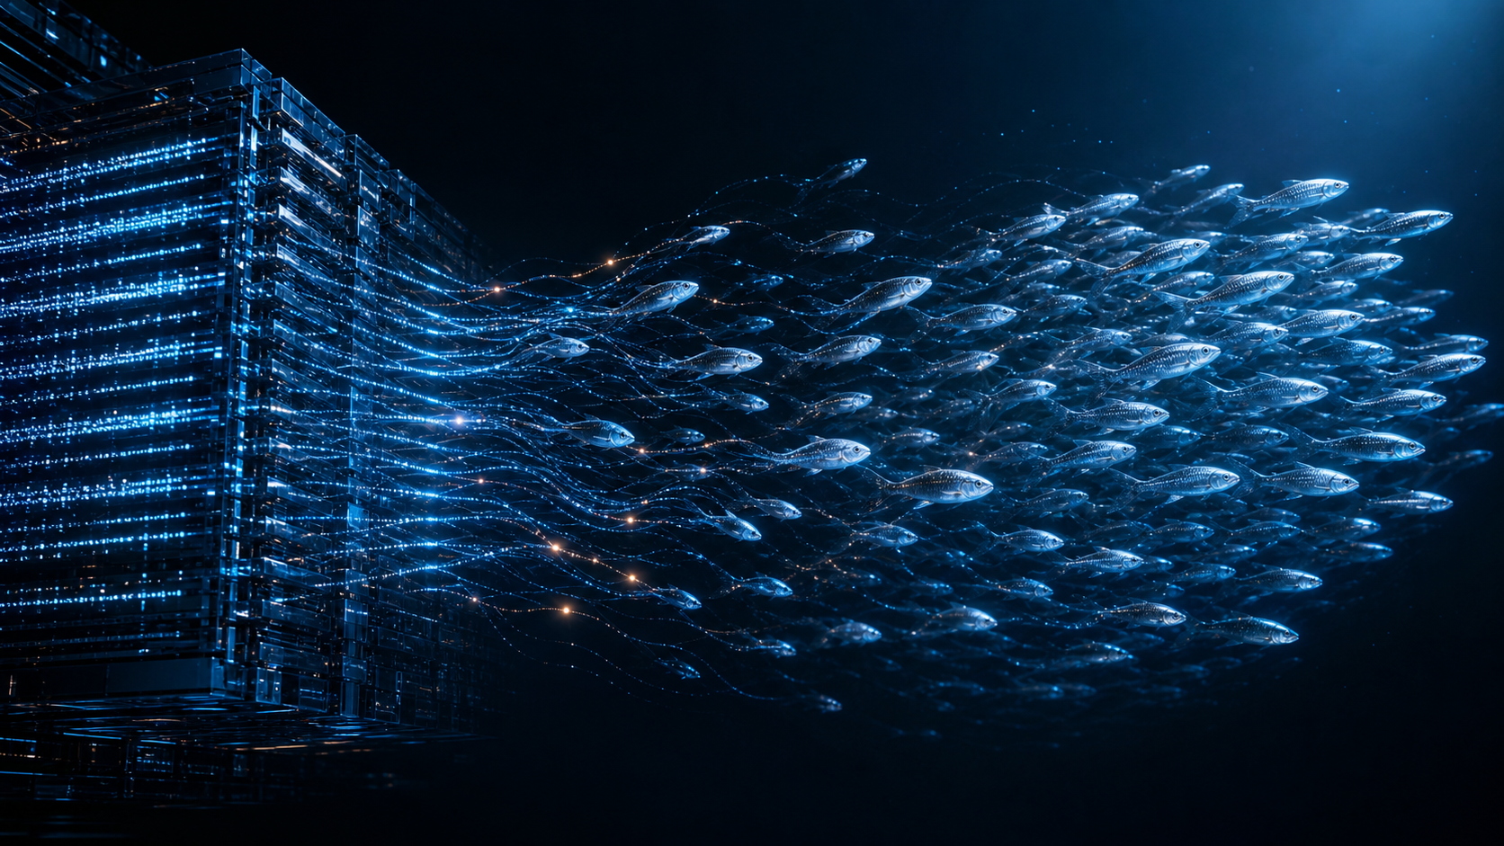

Slide 13
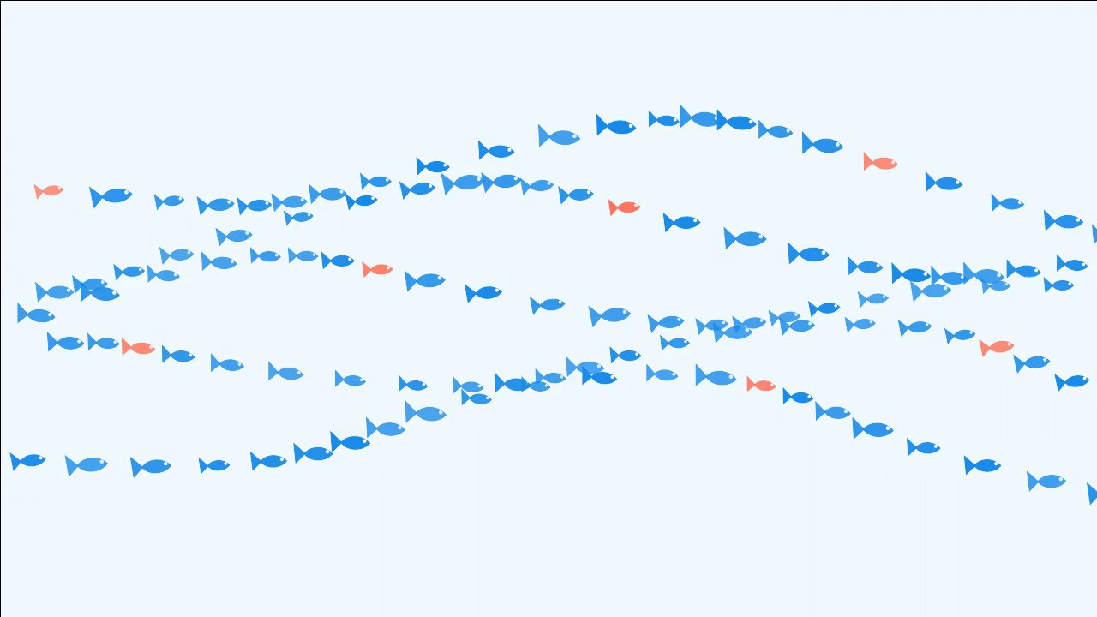
Example: Boids Simulation
13

Slide 14
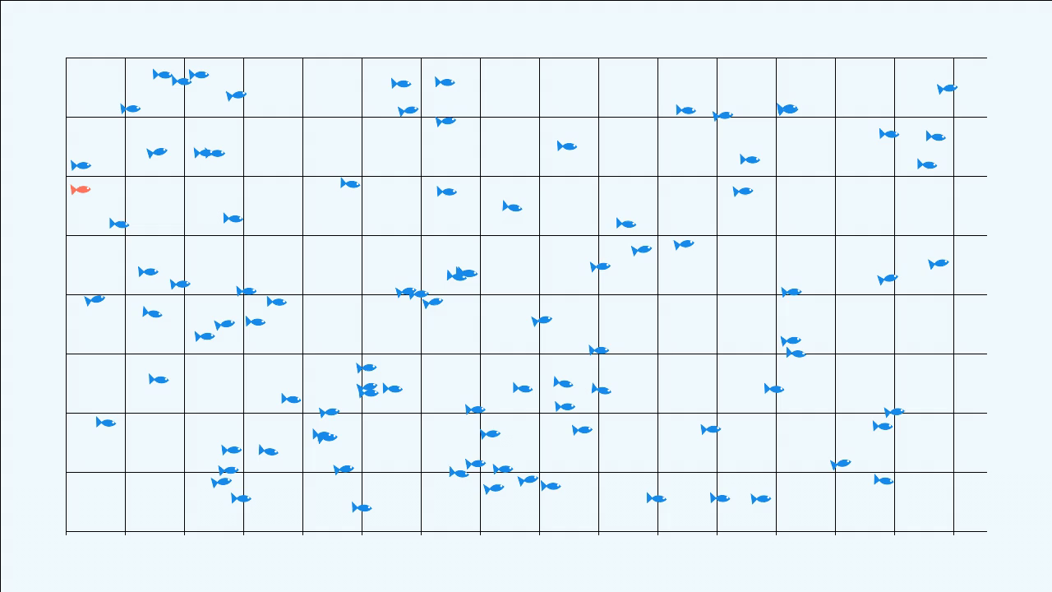

Slide 15

Boids V0: Random Scheduling
W0
for (c : nearby(i))
for (j : fish(c))
force += repel(i,j);
W1
W2
W3
15

Slide 16
Boids V0: Active Lanes
active lanes
latency
speedup
15.01 / 32
18.40 ms
1.00×
16

Slide 17
Boids V0 vs V1: Scheduling
V0
V1
for (i : original_order)
update(i);
sort(targets, by_cell);
for (i : targets)
update(i);
17

Slide 18
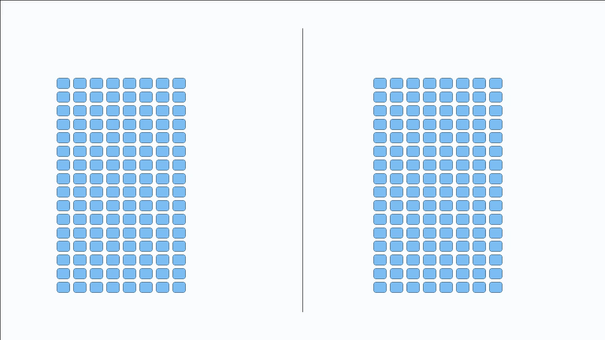
Boids V0 vs V1: Execution
V0
V1
W0
W0
W1
W1
W2
W2
W3
W3
18

Slide 19
Boids V1: Coherent Warps
V0 active lanes
V1 active lanes
V0
V1
15.01
32.00
18.40 ms
13.45 ms
1.37×
19

Slide 20
Boids V1 vs V2: Data Layout
AoS
SoA
struct Fish {
float x, y;
float vx, vy;
float r, g, b, phase;
};
Fish fish[N];
float x[N];
float y[N];
// positions only
20

Slide 21
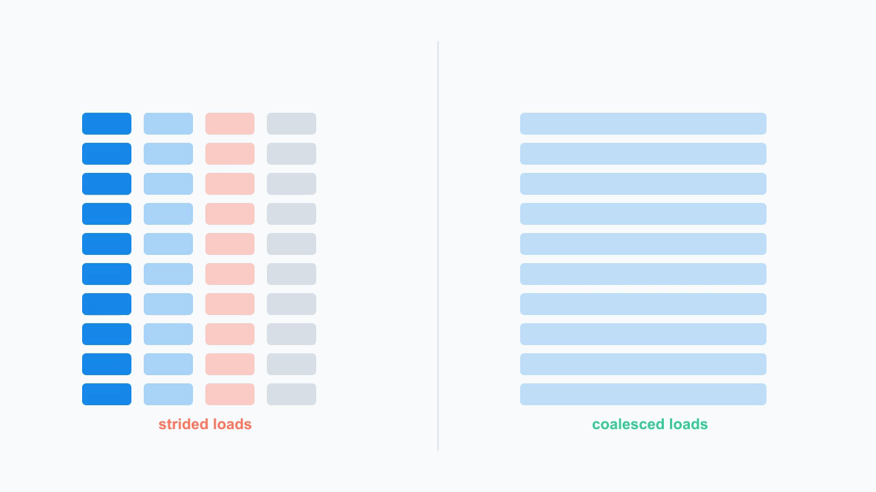
Boids V1 vs V2: Memory Access
AoS
SoA
21

Slide 22
Boids V2: Coalesced Memory
V1 excessive sectors
V2 excessive sectors
latency
9.65B
0.703B
9.70 ms
1.90× vs V0
22

Slide 23
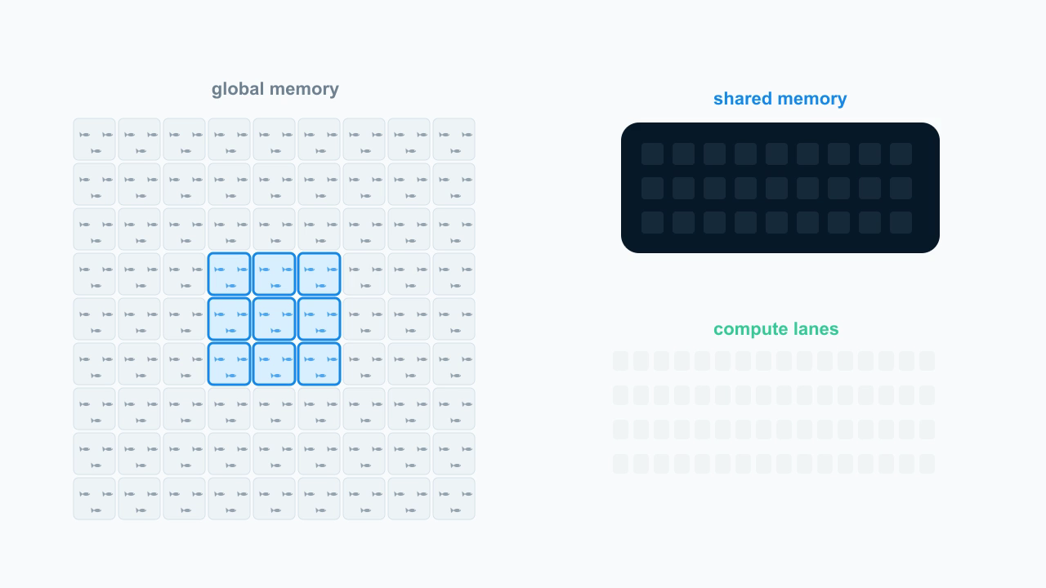
Boids V3: Shared Memory
23

Slide 24
Boids V2 vs V3: Data Reuse
V2
V3
for (j : neighbor) {
p = global_position[j];
force += avoid(i, p);
}
tile = shared_load(neighbor);
sync();
for (p : tile)
force += avoid(i, p);
24

Slide 25
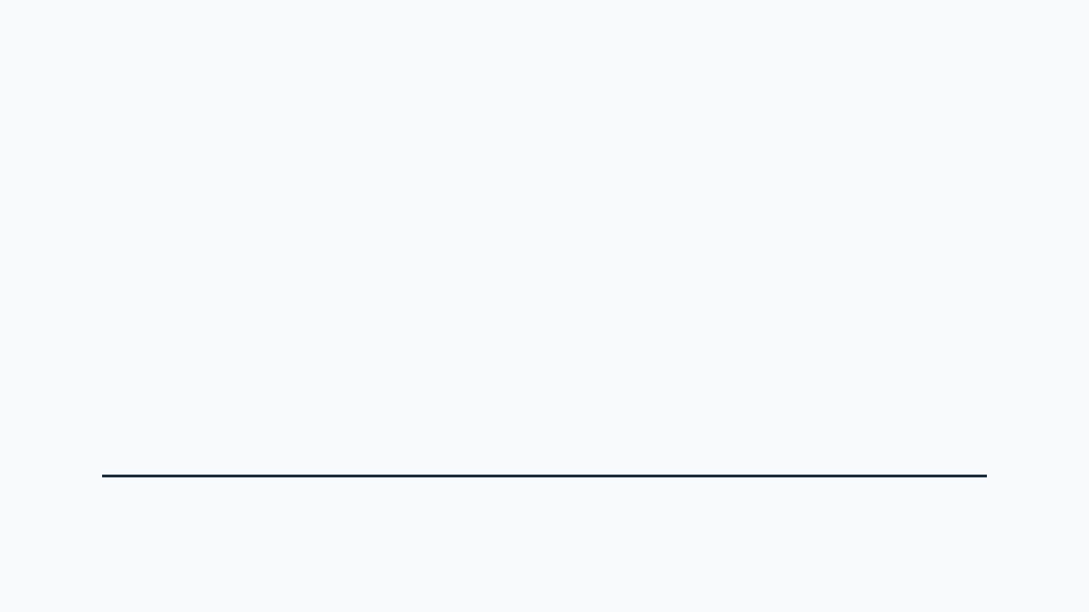
Boids: Performance
V0
V1
V2
V3
18.40 ms 1.00×
13.45 ms 1.37×
9.70 ms 1.90×
7.23 ms 2.54×
26

Slide 26
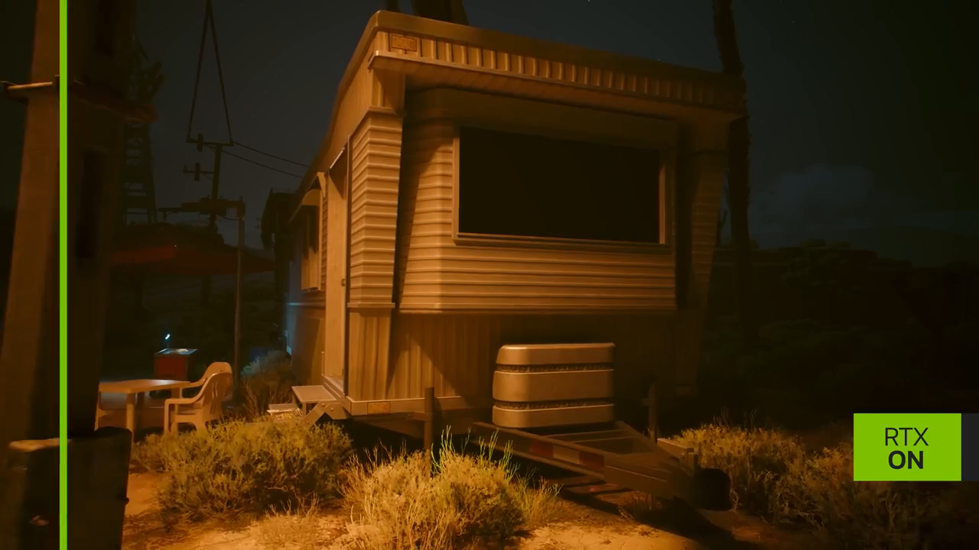
Ray Tracing: RTX ON / OFF
27

Slide 27
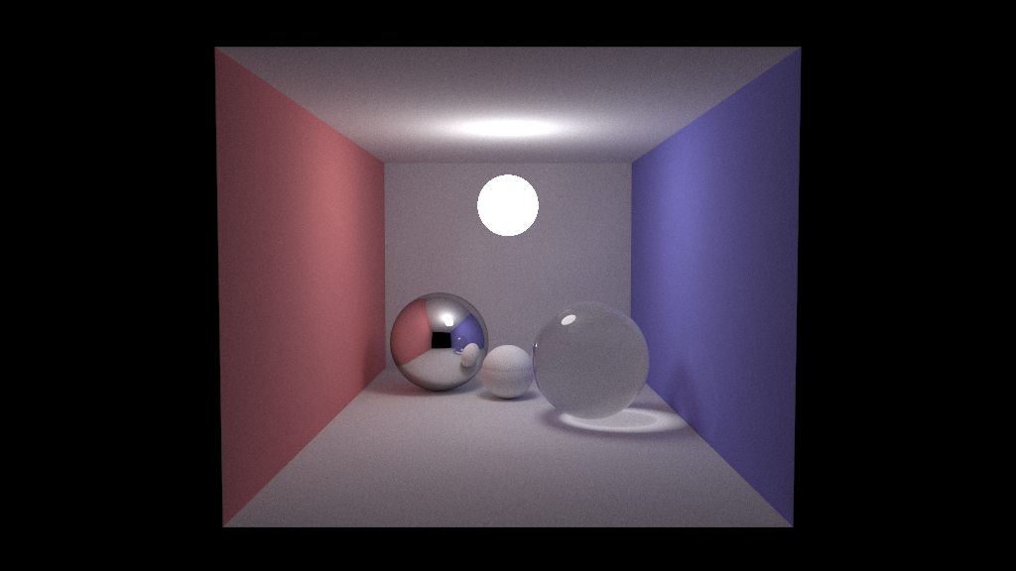

Slide 28
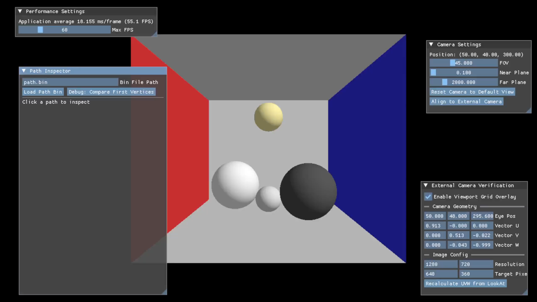

Slide 29
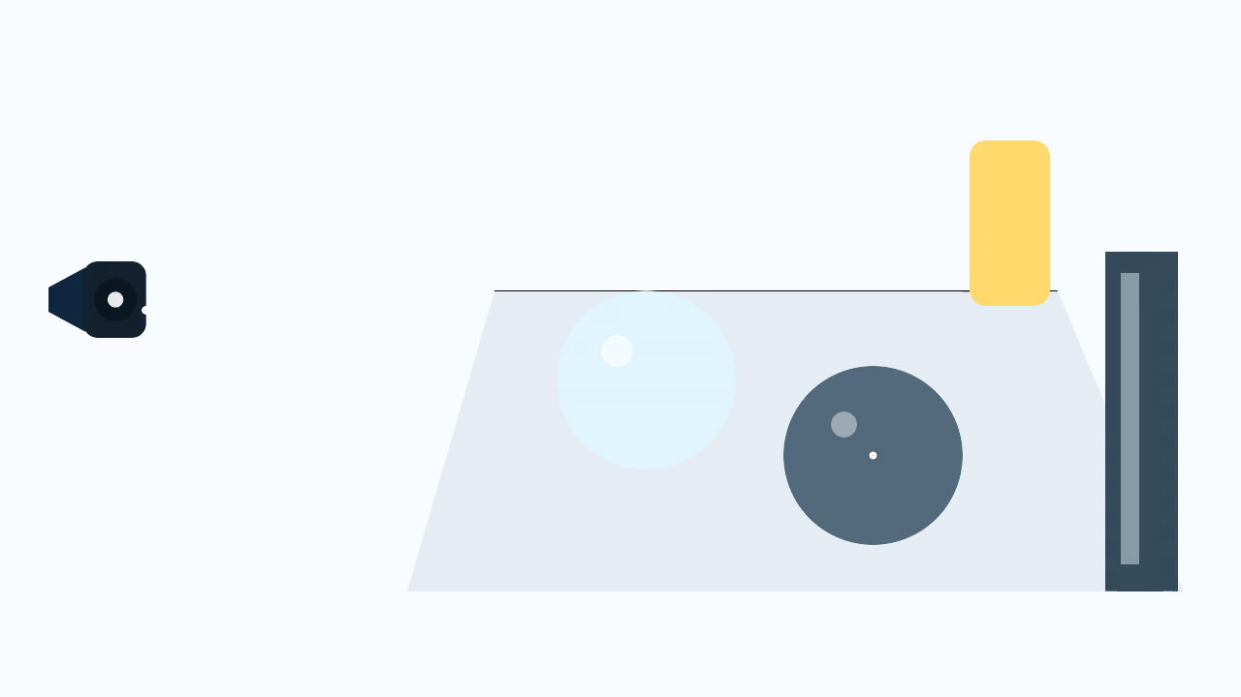
Path Tracing
28

Slide 30
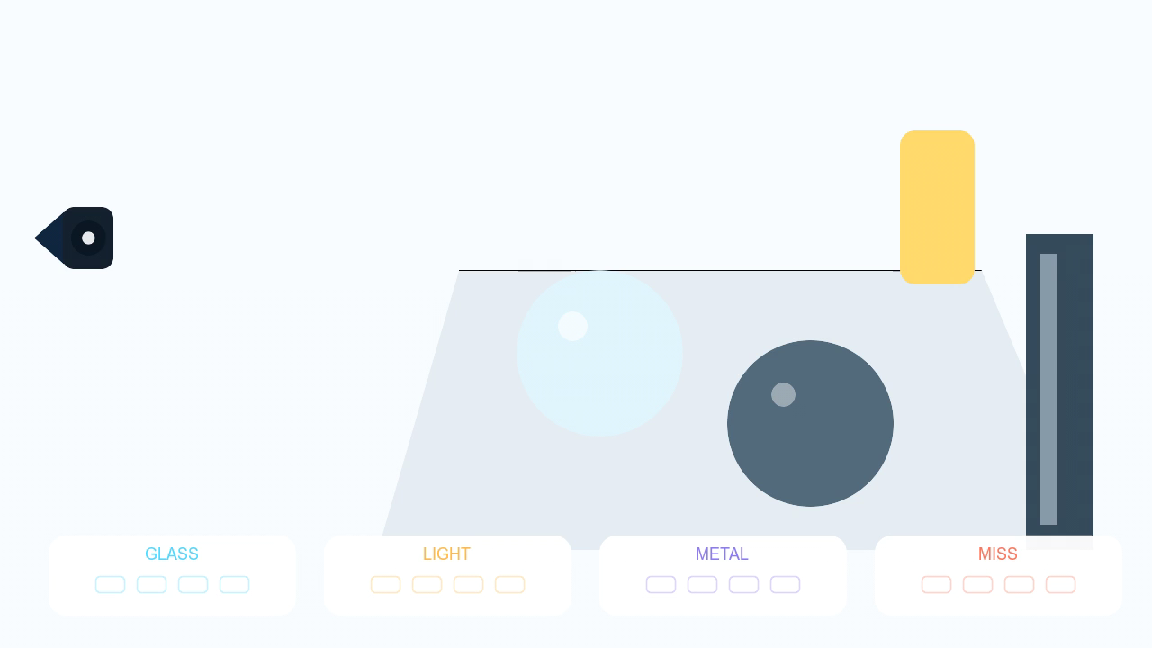
Divergence in Ray Tracing
29

Slide 31
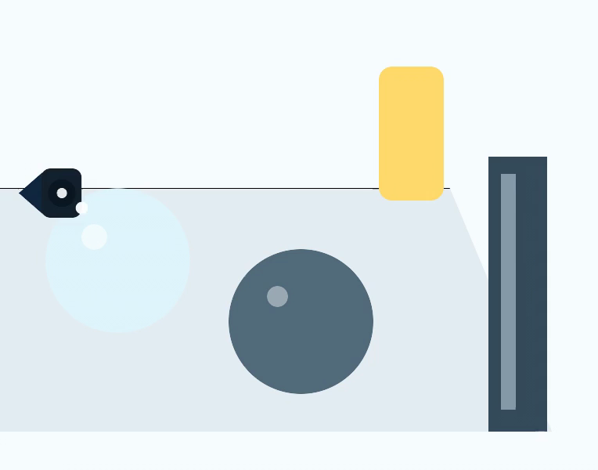
Megakernel Ray Tracing
Megakernel
while (ray.alive) {
hit = intersect(ray);
if (!hit) break;
if (glass(hit))
ray = refract(hit);
else
ray = shade(hit);
}
30

Slide 32
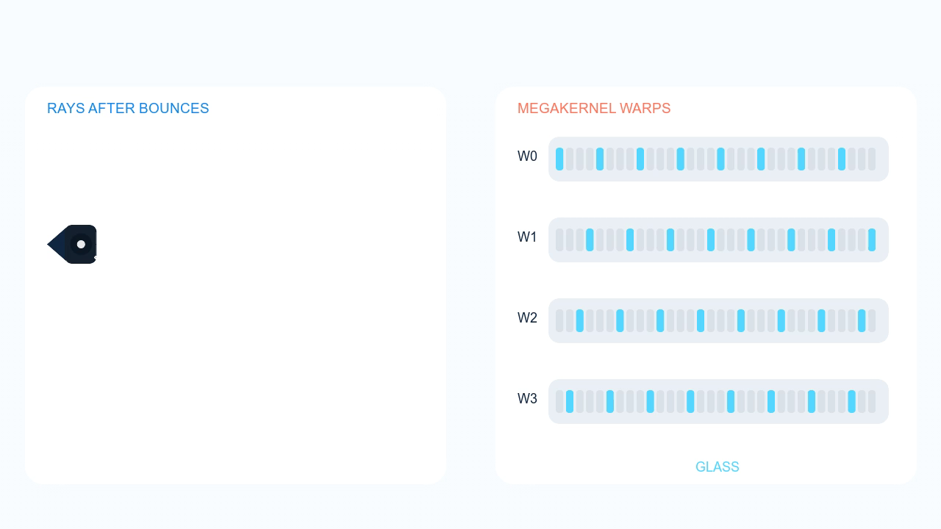
Megakernel Ray Tracing: Stalls
31

Slide 33
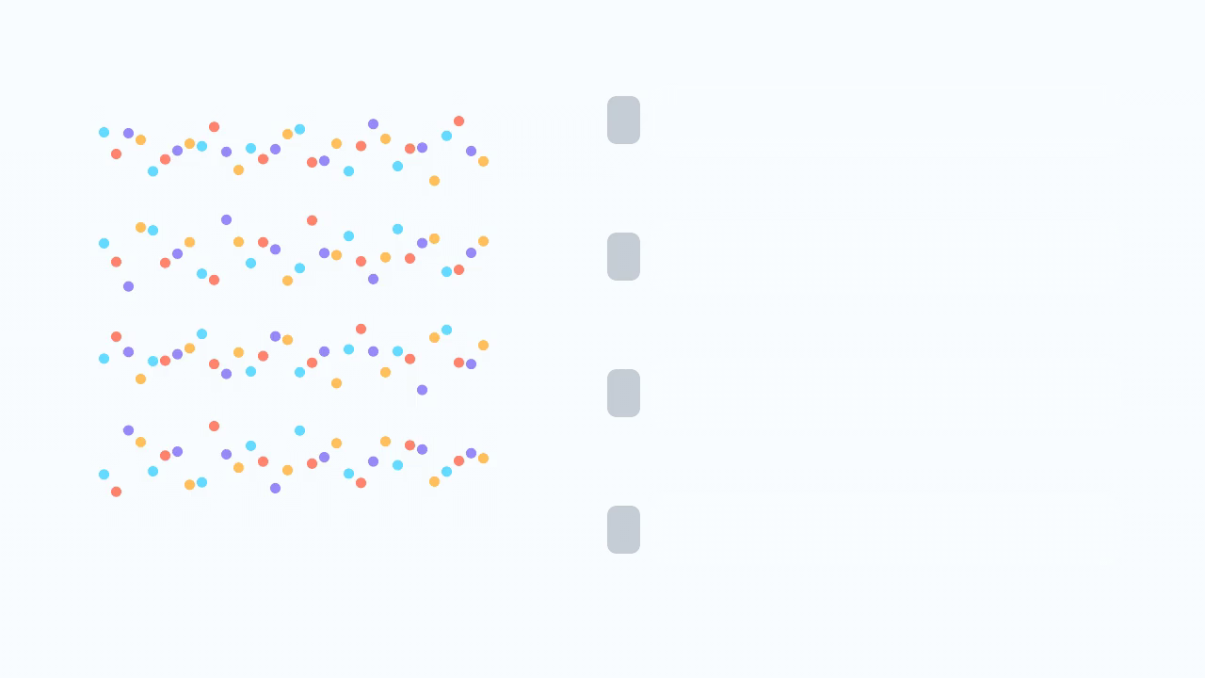
Ray Regrouping
32

Slide 34
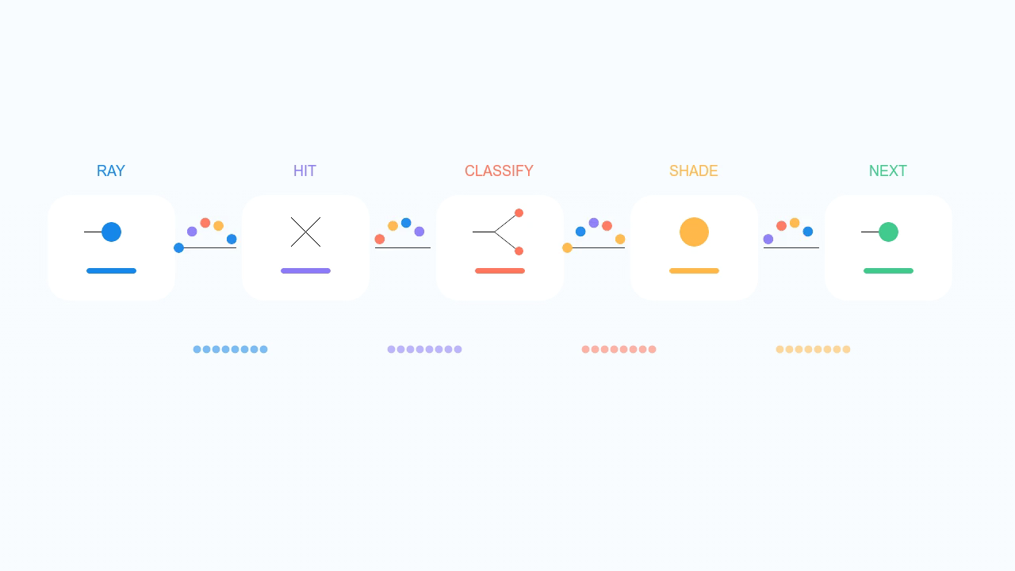
Wavefront Ray Tracing
33

Slide 35
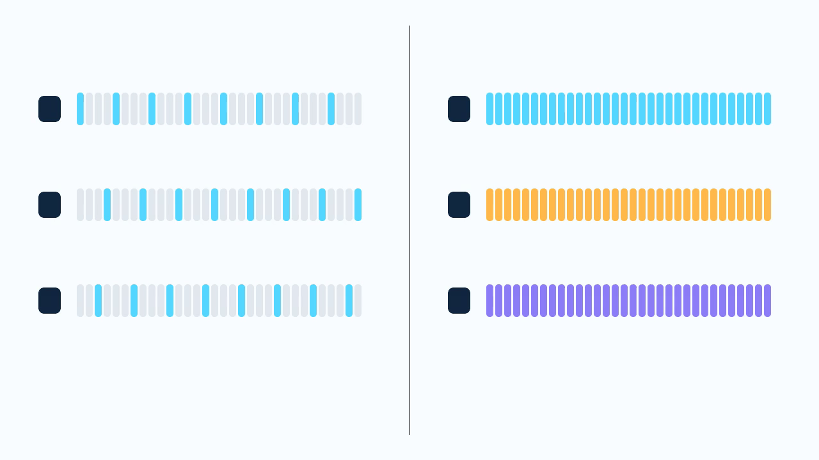
Wavefront Ray Tracing
34

Slide 36
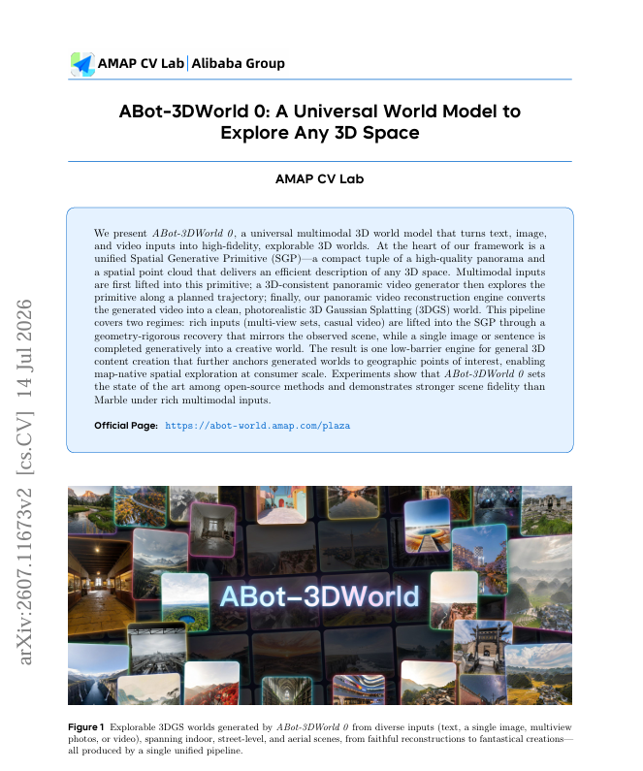

Modern 3D Vision (Graphics) Research
https://arxiv.org/abs/2607.11673
35

Slide 37
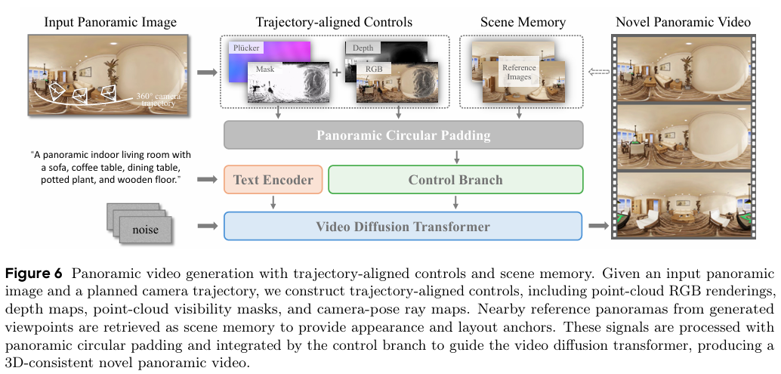
Modern 3D Vision (Graphics) Research
35

Slide 38

Transformer: Next-Token Prediction
35

Slide 39
Transformer: Attention
36

Slide 40
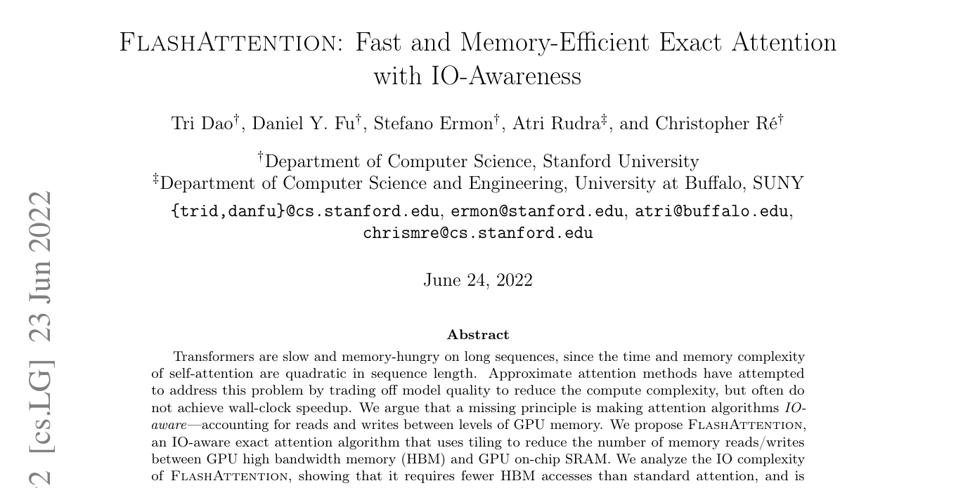
FlashAttention
37

Slide 41
FlashAttention: Tiling
38

Slide 42
FlashAttention: Pseudocode
Standard
FlashAttention
S = Q @ K.T
P = softmax(S)
O = P @ V
HBM.write(S)
HBM.write(P)
for Q_i in tiles(Q):
m, l, A = -inf, 0, 0
for K_j, V_j in tiles:
S = Q_i @ K_j.T
m, l, A = update(S, V_j)
O_i = A / l
39

Slide 43
Attention: Materialization
40

Slide 44
FlashAttention: QKV Tiling
41

Slide 45
FlashAttention: Online Softmax
42

Slide 46
FlashAttention: HBM Traffic
43

Slide 47
Order from Divergence
Mastering Large-Scale Computation
with Minimal Time Complexity Constants
Zhuoran Yi · Fei Yu
Utah Graphics Lab · VCL Imaging Group, Peking University

